Slide 1
Ecommerce Website

Slide 2
PREPARED BY
TANVI Ruthvik Vishal Selas Rohit

Slide 3
TABLE OF CONTENT
Introduction
Abstract
Objectives
Advantages
Future Work
TECHNOLOGY USED
Dashboard
REQUIREMENTS

Slide 4
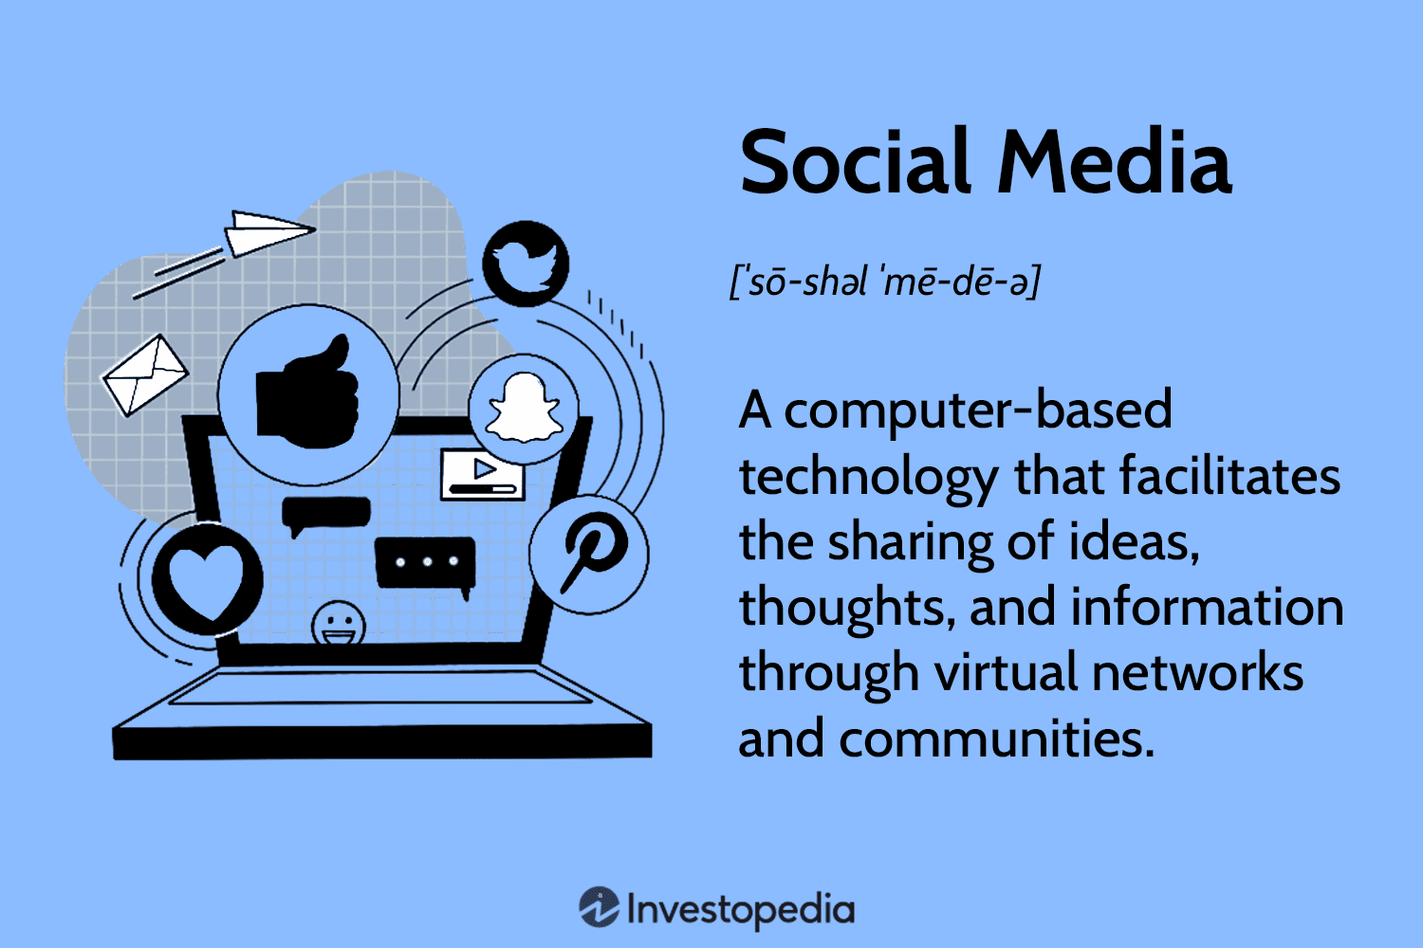
INTRODUCTION
This project focuses on developing a modern e-commerce website using the Go programming language to meet the growing demands of online shopping. The platform is designed to provide an intuitive user interface, enabling easy navigation and quick access to products. It incorporates essential features like dynamic product display. By utilizing Go’s speed and scalability, the website delivers a responsive and reliable experience, tailored for both users and businesses.

Slide 5
ABSTRACT
This e-commerce website project, built using the Go programming language, is designed to provide a seamless online shopping experience. It features a user-friendly interface, efficient product management, and secure payment integration. The platform offers dynamic product listings, search functionality, and a responsive design for accessibility across devices. By leveraging Go’s high performance and scalability, the website ensures faster load times and a robust backend, making it suitable for modern online retail needs.

Slide 6
OBJECTIVES
Enhance User Experience: Design a user-friendly platform that simplifies navigation and product search for customers.
High Performance: Leverage Go's concurrency model for faster response times and efficient backend processing.
Robust Scalability: Build an architecture capable of handling increased traffic and expanding features as business needs grow.
Customer Engagement: Integrate features like Blogs boost customer interaction.
Data Security and Privacy: Ensure that user and transactional data are protected through secure storage and compliance with privacy standards.

Slide 7
ADVANTAGES
Enhanced User Experience: User-friendly interface for easy navigation and smooth shopping.
High Performance: Faster response times with Go’s concurrency, even during high traffic.
Robust Scalability: Efficiently handles growing traffic and expanding features.
Increased Customer Engagement: Features like blogs boost interaction and brand loyalty.
Enhanced Data Security and Privacy: Secure storage and encryption to protect user data.

Slide 8
Future Work
Continuous Optimization: Regularly update the website with new features, performance improvements, and bug fixes based on user feedback.
Real-Time Chat Support: Add AI-powered chatbots or live chat functionality for real-time customer support.
Mobile App Development: Create a dedicated mobile app for a more seamless shopping experience on smartphones and tablets.

Slide 9

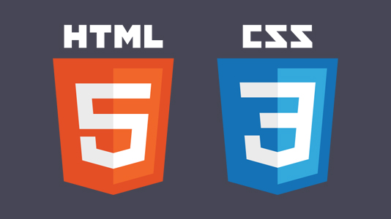

TECHNOLOGY USED

Slide 10
Dashboard
Login Page
Home Page
Blog Page
Product List Page
Checkout Page
Contact Us Page
Database

Slide 11
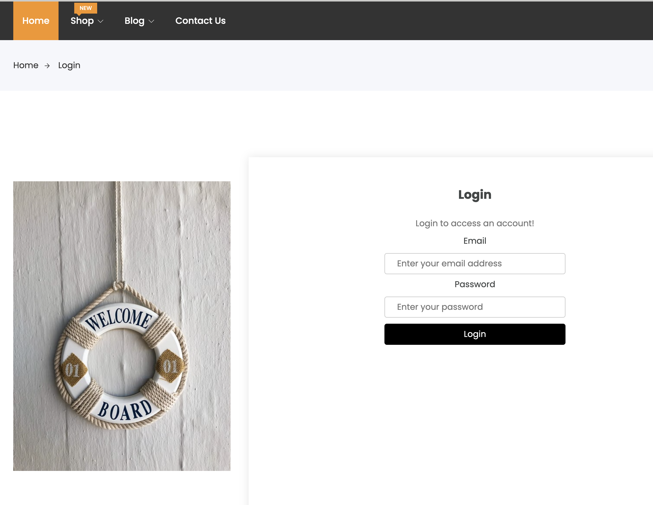
Login Page

Slide 12
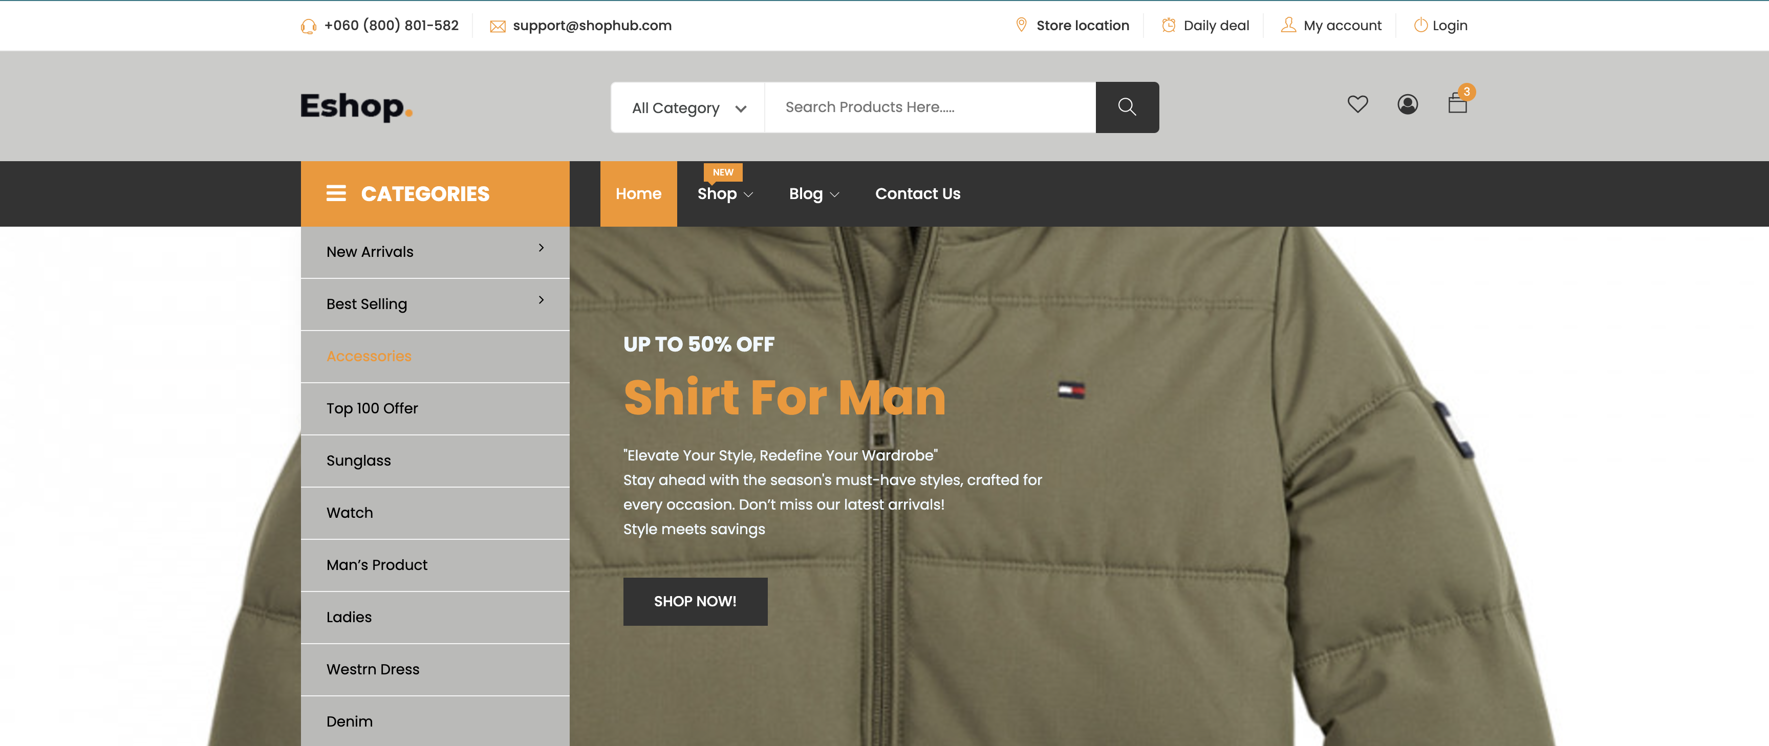
HOME PAGE

Slide 13
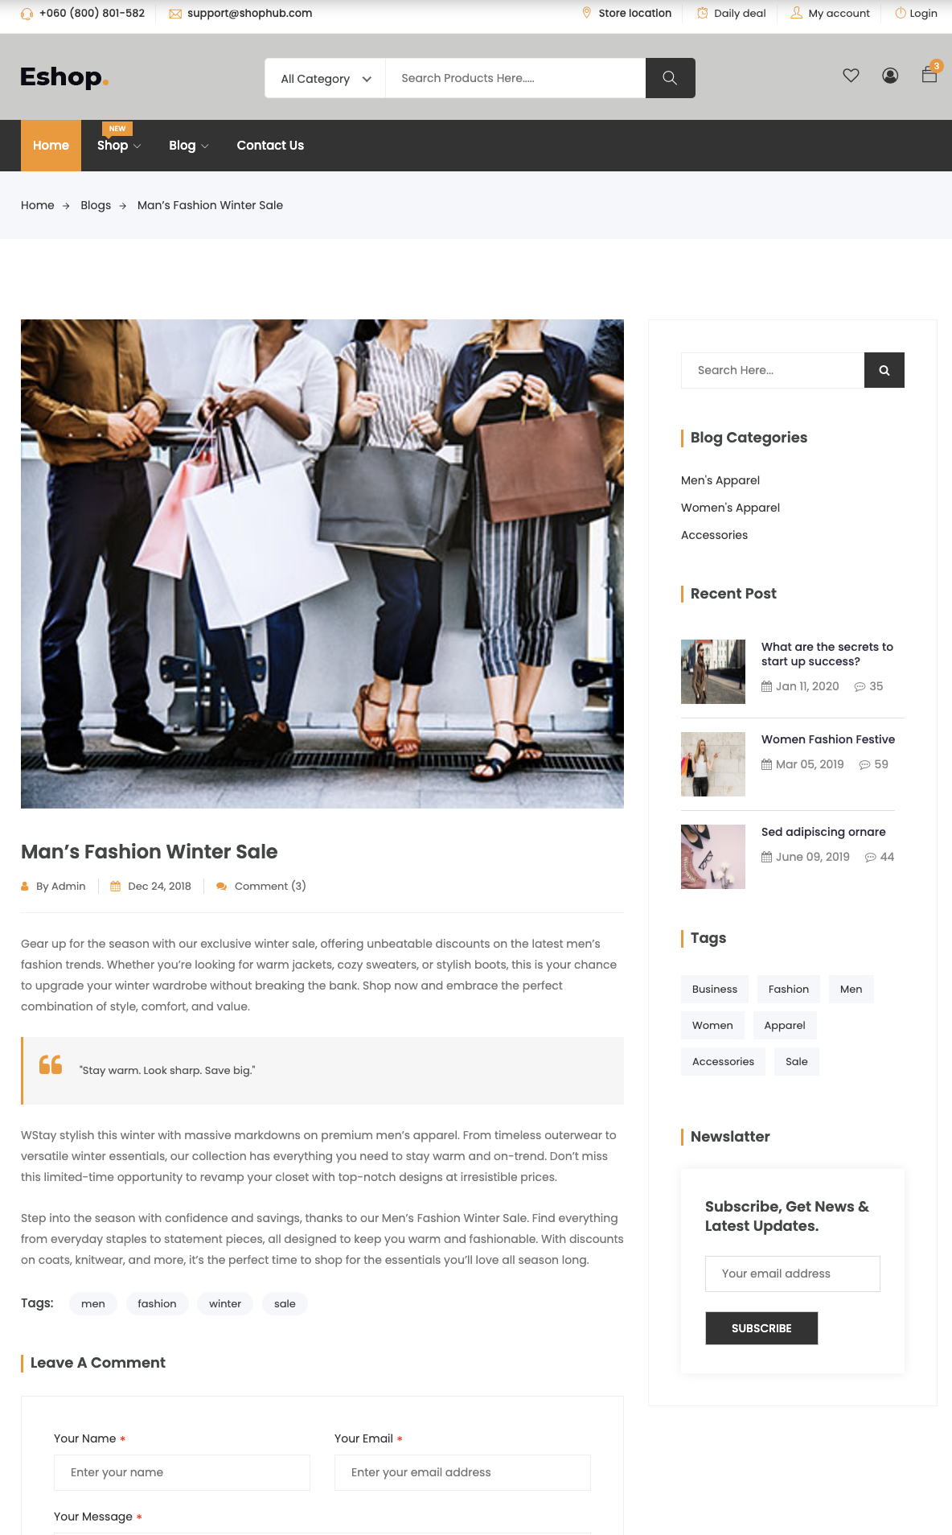
Blogs page

Slide 14
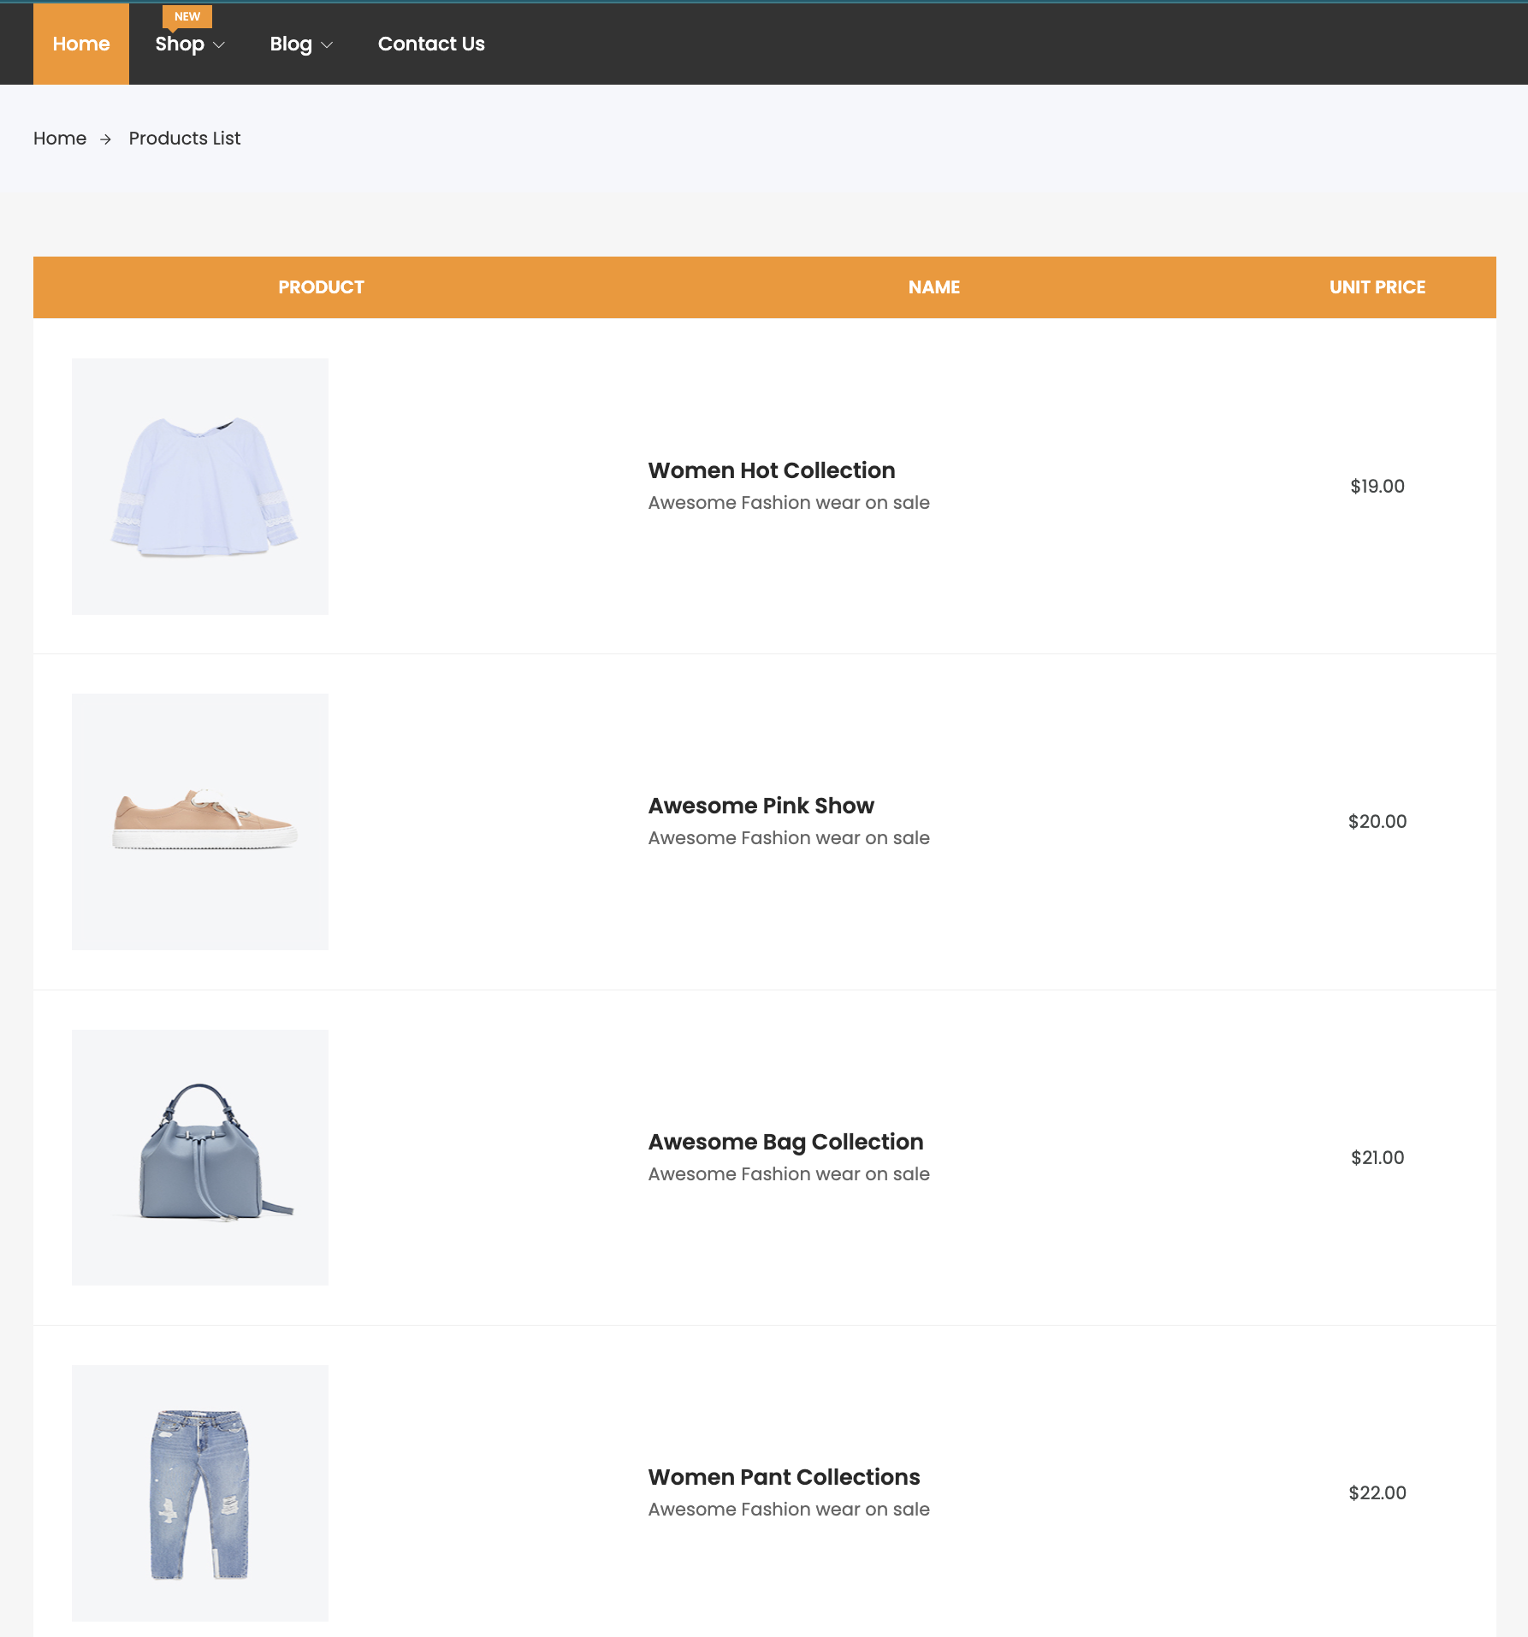
Product Lists

Slide 15
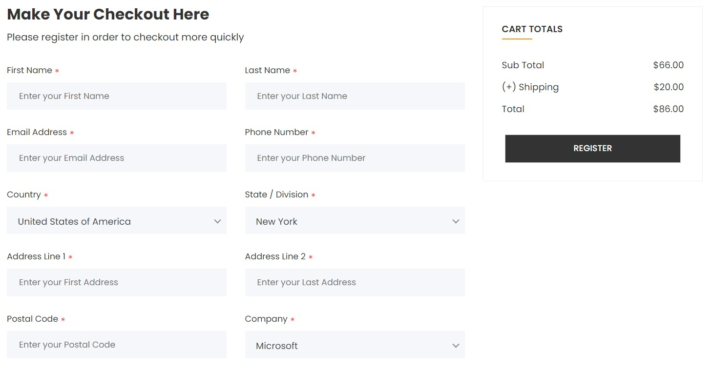
CHECKOUT PAGE

Slide 16
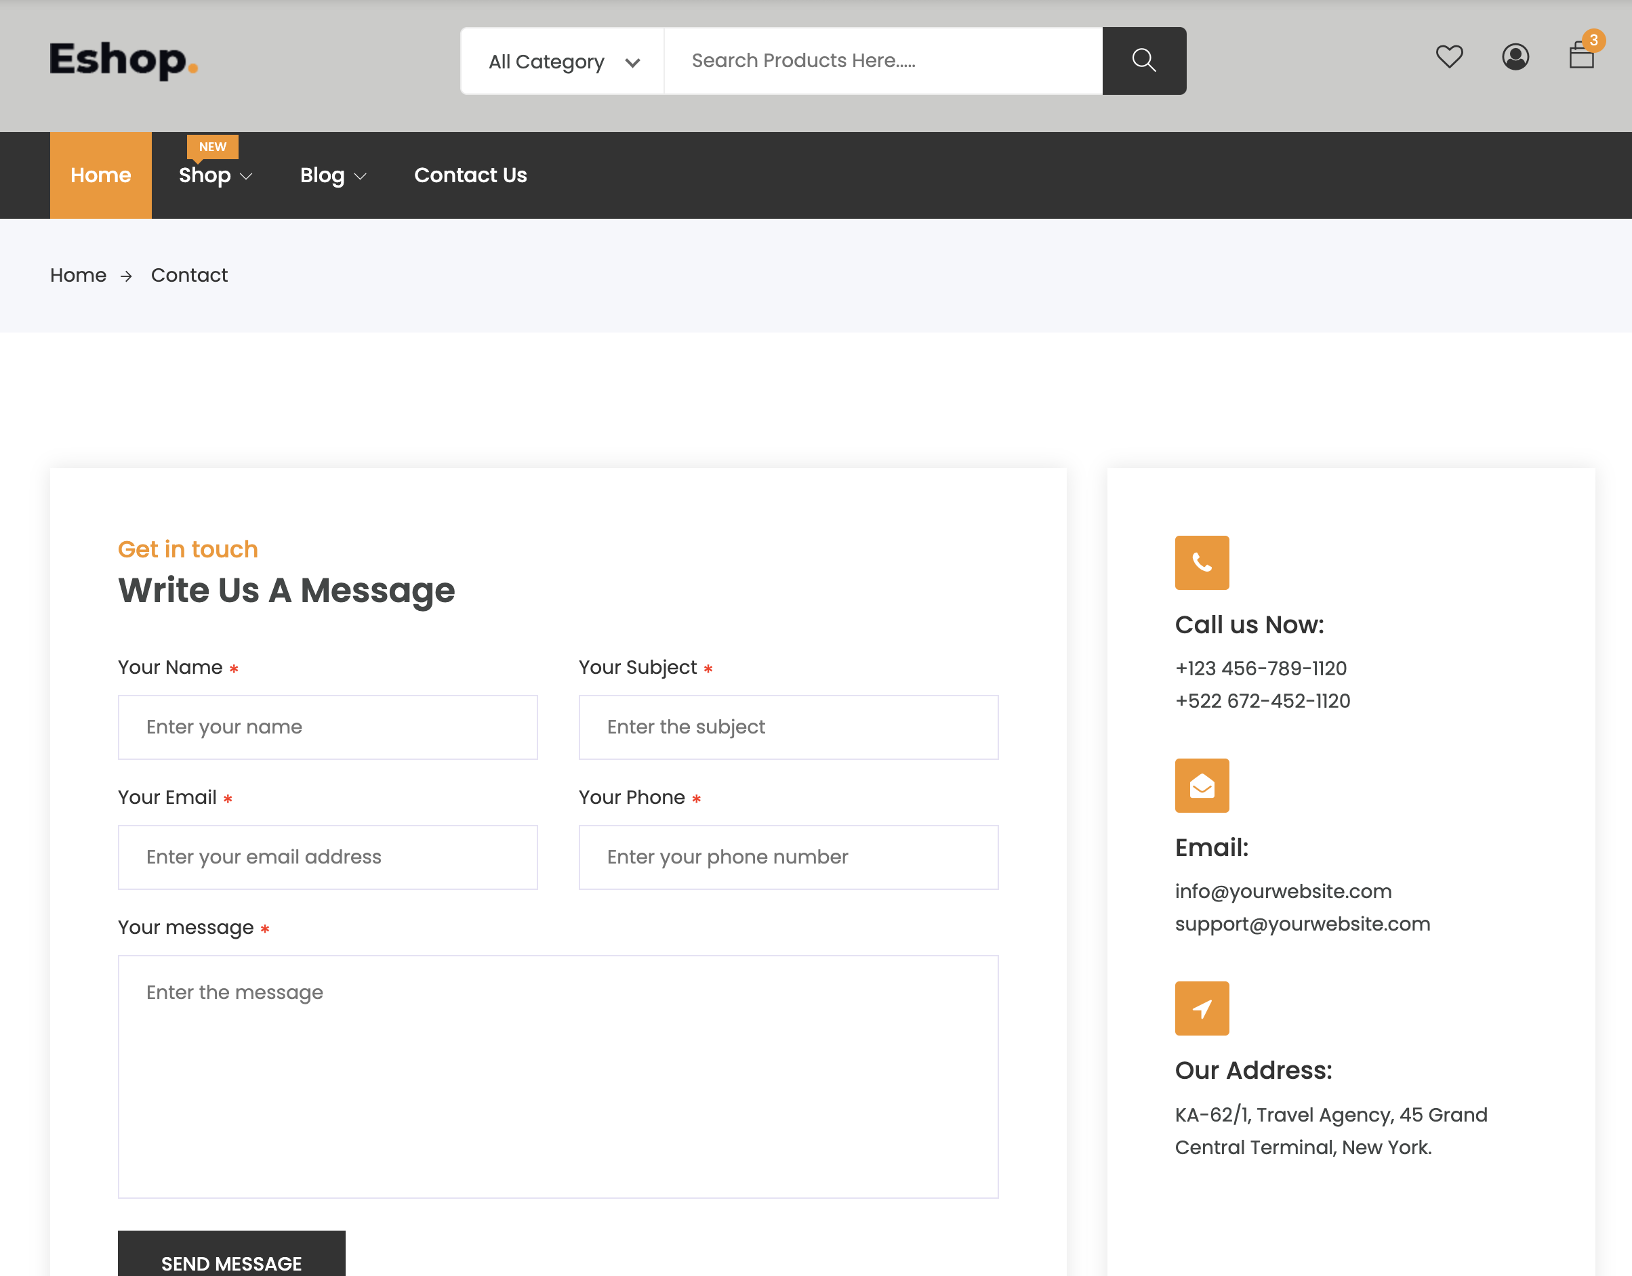
Contact Us

Slide 17
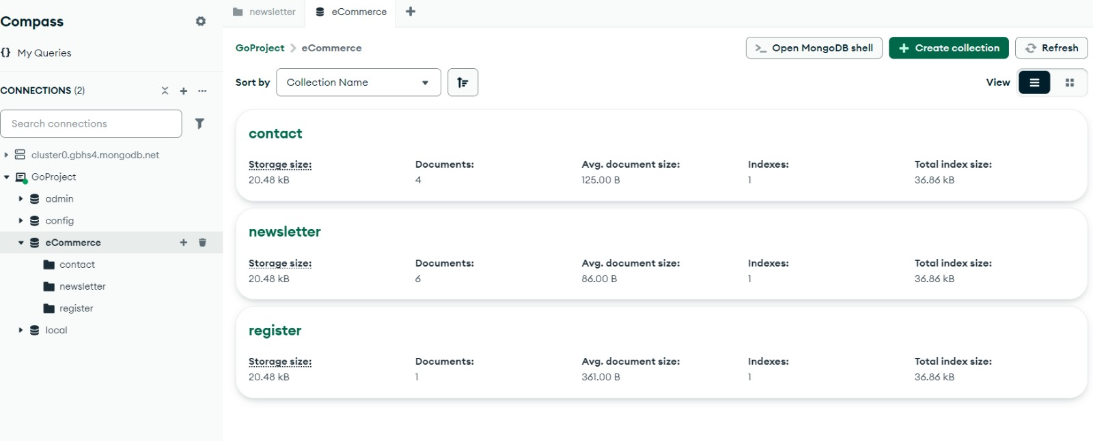
DATABASE

Slide 18
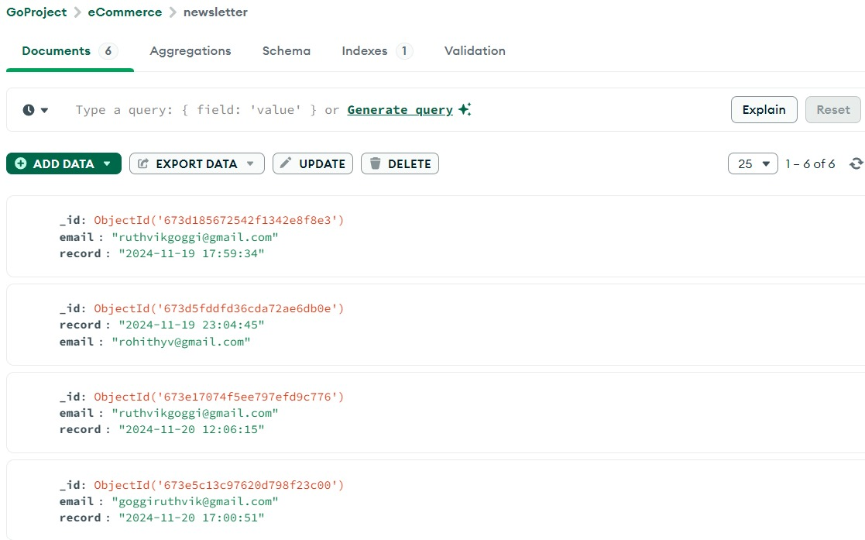
DATABASE

Slide 19
SOFTWARE REQUIREMENTS
Frontend Tool: HTML, CSS.
Backend: Go Programming Language, Go Modules.
Database: Mongodb
OS: Windows, macOS, or Linux.
Browser: Google Chrome, Brave, Mozilla Firefox etc
Version Control: Git, GitHub/GitLab

Slide 20
HARDWARE REQUIREMENTS
Processor: 2.20GHz
Ram: 8GB
Hard Disk: 1TB free space

Slide 21
–THANK YOU

